Slide 1
Thrive Discipleship & Apologetics
Proverbs 11
28 Those who trust in their riches will fall, but the righteous will thrive like a green leaf.
Jude
3 Beloved, while I was very diligent to write to you concerning our common salvation, I found it necessary to write to you exhorting you to contend earnestly for the faith which was once for all delivered to the saints.
Intelligent Design
Psalm 139
14 I will praise You, for I am fearfully and wonderfully made; Marvelous are Your works, And that my soul knows very well.

Slide 2
According to Merriam Webster, the term “intelligent design” has been used since at least 1847, in reference to “the theory that matter, the various forms of life, and the world were created by a designing intelligence.” That’s a decent definition, also consistent with those offered by today’s proponents of intelligent design (ID). For example, the leading ID think tank, The Discovery Institute (Seattle), has this:
Intelligent design refers to a scientific research program as well as a community of scientists, philosophers and other scholars who seek evidence of design in nature. The theory of intelligent design holds that certain features of the universe and of living things are best explained by an intelligent cause, not an undirected process such as natural selection.
https://biologos.org/articles/intelligent-design-history-and-beliefs?gclid=Cj0KCQjwhdTqBRDNARIsABsOl9-z8sCT6k5qzddCU9N9PavvkEpeHHhcF_u40GxtVX8QXuWXI1Mo6s0aApK1EALw_wcB (Retrieved 08/15/219)

Slide 3
Is there any evidence we are created by design?
Lets look at a few facts about the complexity of life.
1. The DNA Strand
The letters DNA stand for “Deoxyribonucleic acid, one of the two forms of nucleic acid in living cells; the genetic material for all cellular life forms and many viruses.”
The other of the two life forms of nucleic acid is RNA. The letters RNA stand “Ribonucleic acid.”
(https://www.ncbi.nlm.nih.gov/books/NBK21134/) (Retrieved 08/02/2019)

Slide 4
DNA was discovered in 1869 by Johann Friedrich Miescher, a Swiss biochemist working in Tübingen, Germany.
The first extracts that Miescher made from human white blood cells were crude mixtures of DNA and chromosomal proteins, but the following year he moved to Basel, Switzerland (where the research institute named after him is now located) and prepared a pure sample of nucleic acid from salmon.
Miescher's chemical tests showed that DNA is acidic and rich in phosphorus, and also suggested that the individual molecules are very large, although it was not until the 1930s when biophysical techniques were applied to DNA that the huge lengths of the polymeric chains were fully appreciated.

Slide 5
1.1.1. Genes are made of DNA
How could the molecular nature of the genetic material be determined?
Back in 1903, WS Sutton had realized that the inheritance patterns of genes paralleled the behavior of chromosomes during cell division.
This observation led to the proposal that genes are located in chromosomes and by the 1930s it was universally accepted that the chromosome theory was correct.
The next Fact
2. Chromosomes.
Chromosomes are thread-like structures located inside the nucleus of animal and plant cells. Each chromosome is made of protein and a single molecule of deoxyribonucleic acid (DNA). Passed from parents to offspring, DNA contains the specific instructions that make each type of living creature unique. Jun 16, 2015
Chromosomes Fact Sheet - National Human Genome Research ...
https://www.genome.gov/about-genomics/fact-sheets/Chromosomes-Fact-Sheet
(Retrieved 08/05/2019)

Slide 6
Examination of cells by cytochemistry, after staining with dyes that bind specifically to just one type of biochemical, had shown that chromosomes are made of DNA and protein, in roughly equal amounts.
The Human Genome Project estimated that humans have between 20,000 and 25,000 genes. Jul 16, 2019
Another Fact
3. Genes
plural noun: genes (in informal use) a unit of heredity which is transferred from a parent to offspring and is held to determine some characteristic of the offspring. "proteins coded directly by genes"
(in technical use) a distinct sequence of nucleotides forming part of a chromosome, the order of which determines the order of monomers in a polypeptide or nucleic acid molecule which a cell (or virus) may synthesize.

Slide 7
In humans, each cell normally contains 23 pairs of chromosomes, for a total of 46. Twenty-two of these pairs, called autosomes, look the same in both males and females. The 23rd pair, the sex chromosomes, differ between males and females. Jul 16, 2019 https://ghr.nlm.nih.gov/primer/basics/howmanychromosomes
And their final count is…37.2 trillion. Calculating the number of cells in the human body is tricky. Part of the problem is that using different metrics gets you very different outcomes. Guessing based on volume gets you an estimate of 15 trillion cells; estimate by weight and you end up with 70 trillion. Oct 24, 2013 https://www.smithsonianmag.com/.../there-are-372-trillion-cells-in-your-body-4941473/

Slide 8
3. The Cell (biology) The cell is the structural and functional unit of all living organisms, and is sometimes called the "building block of life." Some organisms, such as bacteria, are unicellular, consisting of a single cell.
Cell (biology) - ScienceDaily
https://www.sciencedaily.com/terms/cell_(biology).htm
(Retrieved on 08/05/2019)
How wide is a DNA stand?
DNA is stored in the nucleus of cells. It is an extremely thin molecule averaging about 2 nanometers in width. A nanometer is one-billionth of a meter. To put this in perspective, a human hair is approximately 80,000 nanometers wide.
https://www.mrsec.psu.edu/content/how-see-dna-naked-eye

Slide 9
A single byte (or 8 bits) can represent by 4 DNA base pairs. In order to represent the entire diploid human genome in terms of bytes, we can perform the following calculations: 6×10^9 base pairs/diploid genome x 1 byte/4 base pairs = 1.5×10^9 bytes or 1.5 Gigabytes, about 2 CDs worth of space!
https://bitesizebio.com/8378/how-much-information-is-stored-in-the-human-genome/
Diploid cells have two homologous copies of each chromosome, usually one from the mother and one from the father. ... Human diploid cells have 46 chromosomes https://www.nature.com/scitable/definition/diploid-310/

Slide 10
Data storage across the whole organism
Some interesting question could follow. For example, how many megabytes of genetic data are stored in the human body?
For simplicity’s sake, let’s ignore the microbiome (all non-human cells that live in our body), and focus only on the cells that make up our body. Estimates for the number of cells in the human body range between 10 trillion and 100 trillion. Let us take 100 trillion cells as the generally accepted estimate. So, given that each diploid cell contains 1.5 GB of data (this is very approximate, as I am only accounting for the diploid cells and ignoring the haploid sperm and egg cells in our body), the approximate amount of data stored in the human body is:
1.5 Gbytes x 100 trillion cells = 150 trillion Gbytes or 150×10^12 x 10^9 bytes = 150 Zettabytes (10^21)!!!

Slide 11
How often are cells replaced in the human body?
No one really knows the exact number of cells, but we can approximate to about 10-50 trillion. Cells are always created and destroyed in the human body. About 300 million cells die every minute in our bodies! Since different cells have different jobs in our body, there are about 210 different "types" of cells. Apr 12, 2013
https://scienceline.ucsb.edu/getkey.php?key=3926
The following show what our body is made of. Information taken from
https://answersingenesis.org/human-body/from-dust-to-dust/

Slide 12
We have looked at five facts
DNA
Chromosomes
Genes
Cells
Some basic ways all of these work together.
A sixth fact to consider is all of the elements our body is made of along with Water.

Slide 13
Major Elements Found in the Human Body (Chemical Symbol) | Abundances of Elements in the Earth’s Crust (Approximate % by weight)
Oxygen (O) 61% Vital role in breathing and metabolism. Nutrient compounds, inside of the cell, are oxidized through complex enzymatic processes. | 46.600
Carbon (C) 23% Virtually every part of the body is made up of molecules based around carbon chains. | 0.030
Hydrogen (H) 10% Critical component of water and other hydrogen bonds. Stomach acid (hydrogen and chlorine) allows digestion, therefore absorption of elements. Many chemical reactions that make life possible involve the hydrogen ion. | 0.140
Nitrogen (N) 2.6% Your body digests Nitrogen and makes it into energy. Nitrogen can be obtained from eating plants or from animals that eat plants (herbivores). | 0.005
Calcium (Ca) 1.4% Structure of bone and teeth. | 3.600
Phosphorous (Ph) 1.1% Structure of bone and teeth. Rebuilding of red blood cells. | 0.130
Potassium (K) .20% Major electrolyte of blood and cellular fluid. Required for maintenance of pH and nervous system. | 2.600
Sulfur (S) .20% Element of the essential amino acids. | 0.030
Sodium (Na) .14% Major electrolyte of blood and cellular fluid. Required for maintenance of pH and water balance. Vital to the transmission of impulses from our brains to muscles. | 2.800
Chlorine (Cl) .12% Major electrolyte of blood and cellular fluid. Balance of pH and water. Used in balancing electrical charges in nervous system. | 0.005
Magnesium (Mg) .027% Important in bone structure. | 2.100
Silicon (Si) .026% Essential nutrient for healthy bone metabolism. | 27.700

Slide 14
Trace Elements
Iron (Fe) .006% Contained in blood, required for oxygen transport. | 5.000
Fluorine (F) .0037% Helps the body strengthen the bones and teeth. | 0.080
Copper (Cu) .0001% Contained in enzymes, which regulate iron transport. | 0.010
Zinc (Zn) .0033% Growth and repair of tissues. Required for DNA binding. Creation, release, and use of hormones. Sight, taste, and smell depend on zinc. | Trace
Aluminum (Al) .00008% Involved in the action of a few enzymes. | 8.100
Manganese (Mn) .00002% Supports the immune system, regulates blood sugar, involved in the production of energy and cell reproduction. Deficiency can lead to improper bone formation. | 0.100
Iodine (I) .00002 Used in production of thyroxine which plays an important role in metabolic rate. | Trace
Selenium (Se) .00002% Helps our immune system produce antibodies, keeps the pancreas and heart functioning properly. Needed to make our tissues elastic. | Trace
Molybdenum (Mo) .000007% Assists the processing of iron and nitrogen. | Trace
Chromium (Cr) .00002% A cofactor in the regulation of sugar levels. | 0.010
Cobalt (Co) .000004% Contained in vitamin B12 which is necessary for the formation of all cells, especially red blood cells. | Trace

Slide 15
 | Element | Percentage | Mass [Kg] | Cost/Kg | Value
O | Oxygen | 65 | 49.14 | $0.20 | $9.83
C | Carbon | 18 | 18.29 | $0.01 | $0.18
H | Hydrogen | 10.2 | 8.00 | $0.20 | $1.60
N | Nitrogen | 3.1 | 2.06 | $0.20 | $0.41
Ca | Calcium | 1.6 | 1.14 | $0.10 | $0.11
P | Phosphorus | 1.2 | 0.89 | $1.00 | $0.89
K | Potassium | 0.25 | 0.16 | $650.00 | $104.00
S | Sulfur | 0.25 | 0.16 | $0.10 | $0.02
Na | Sodium | 0.15 | 0.11 | $250.00 | $28.57
Cl | Chlorine | 0.15 | 0.11 | $1.00 | $0.11
Mg | Magnesium | 0.05 | 0.02 | $3.00 | $0.07
Fe | Iron | 6.00E-03 | 4.80E-03 | $0.20 | $0.00
F | Fluorine | 3.70E-03 | 2.97E-03 | $2,000.00 | $5.94
Zn | Zinc | 3.20E-03 | 2.63E-03 | $2.00 | $0.01
Si | Silicon | 2.00E-03 | 1.14E-03 | $2.00 | $0.00
Rb | Rubidium | 4.60E-04 | 7.77E-04 | $10,000.00 | $7.77

Slide 16
Sr | Strontium | 4.60E-04 | 3.66E-04 | $1,000.00 | $0.37
Br | Bromine | 2.90E-04 | 2.97E-04 | $50.00 | $0.01
Pb | Lead | 1.70E-04 | 1.37E-04 | $0.40 | $0.00
Cu | Copper | 1.00E-04 | 8.23E-05 | $7.00 | $0.00
Al | Aluminium | 8.70E-05 | 6.86E-05 | $2.00 | $0.00
Cd | Cadmium | 7.20E-05 | 5.71E-05 | $10.00 | $0.00
Ce | Cerium | 5.00E-05 | 4.57E-05 | $50.00 | $0.00
Ba | Barium | 3.10E-05 | 2.51E-05 | $60.00 | $0.00
Sn | Tin | 2.40E-05 | 2.29E-05 | $20.00 | $0.00
I | Iodine | 1.60E-05 | 2.29E-05 | $2.00 | $0.00
Ti | Titanium | 1.30E-05 | 2.29E-05 | $8.00 | $0.00
B | Boron | 6.90E-05 | 2.06E-05 | $6,000.00 | $0.12
Se | Selenium | 1.90E-05 | 1.71E-05 | $53.00 | $0.00
Ni | Nickel | 1.40E-05 | 1.71E-05 | $20.00 | $0.00
Cr | Chromium | 2.40E-06 | 1.60E-05 | $20.00 | $0.00
Mn | Manganese | 1.70E-05 | 1.37E-05 | $5.00 | $0.00
As | Arsenic | 2.60E-05 | 8.00E-06 | $5.00 | $0.00
Li | Lithium | 3.10E-06 | 8.00E-06 | $100.00 | $0.00
Hg | Mercury | 1.90E-05 | 6.86E-06 | $40.00 | $0.00
Cs | Caesium | 2.10E-06 | 6.86E-06 | $3,000.00 | $0.02

Slide 17
Mo | Molybdenum | 1.30E-05 | 5.71E-06 | $300.00 | $0.00
Ge | Germanium | 1.30E-05 | 5.71E-06 | $2,000.00 | $0.01
Co | Cobalt | 2.10E-06 | 3.43E-06 | $200.00 | $0.00
Sb | Antimony | 1.10E-05 | 2.29E-06 | $300.00 | $0.00
Ag | Silver | 1.00E-06 | 2.29E-06 | $700.00 | $0.00
Nb | Niobium | 1.60E-04 | 1.71E-06 | $180.00 | $0.00
Zr | Zirconium | 6.00E-04 | 1.14E-06 | $600.00 | $0.00
La | Lanthanum | 2.00E-04 | 9.14E-07 | $1,500.00 | $0.00
Te | Tellurium | 1.20E-05 | 8.00E-07 | $240.00 | $0.00
Ga | Gallium | 1.20E-05 | 8.00E-07 | $1,800.00 | $0.00
Y | Yttrium | 1.20E-05 | 6.86E-07 | $2,000.00 | $0.00
Bi | Bismuth | 1.20E-05 | 5.71E-07 | $400.00 | $0.00
Tl | Thallium | 1.40E-05 | 5.71E-07 | $500.00 | $0.00
In | Indium | 1.40E-05 | 4.57E-07 | $2,000.00 | $0.00
Au | Gold | 1.40E-05 | 2.29E-07 | $40,000.00 | $0.01

Slide 18
Summing up all the amounts in the Value column, we come to a grand total of just over $160.
http://www.datagenetics.com/blog/april12011/
(Retrieved 08/05/2019)
If you take out Potassium = $104
And sodium = $28.57
Our total worth
In elements would be = $27.43
According to a recent article in Wired magazine, a body could be worth up to $45 million — Calculated by selling the bone marrow, DNA, lungs, kidneys, heart … as components. http://www.datagenetics.com/blog/april12011/
(Retrieved 08/05/2019)

Slide 19
I think the complexity of life and the way human life functions show that we have a designer. We have seen in this short presentation that as Psalm 139:14 states, we are fearfully and wonderfully made. Please note we have only began to scratch the surface.
If you are not convinced, perhaps the following will give you more food for thought.
To explain the Law of Biogenesis there are two competing models, one is creation, and the other is evolution.
Can evolution truly explain why we are here?

Slide 20
In the early 19th century Jean-Baptiste Lamarck (1744 – 1829) proposed his theory of the transmutation of species, the first fully formed theory of evolution. In 1858 Charles Darwin and Alfred Russel Wallace published a new evolutionary theory, explained in detail in Darwin's On the Origin of Species (1859). https://en.wikipedia.org/wiki/History_of_evolutionary_thought
(Retrieved on 08/15/2019)
The theory of evolution is split up into three camps.
The fossil Record shows the evolutionary process.
Genetics show the evolutionary process.
Our planet was seeded by Aliens.

Slide 21
Richard Dawkins one of the leading evolutionists, and best known champion of Atheism is quoted here in an interview with Ben Stine. Richard Dawkins was a Professor at Oxford University from 1995 to 2008 and now lectures at various universities.
Ben Stine is an economist, and put out the move “Expelled” in 2008 where this quote is found. It is well worth watching.
DAWKINS: Nobody knows how it got started. We know the kind of event that it must have been. We know the sort of event that must have happened for the origin of life. BEN STEIN: And what was that? DAWKINS: It was the origin of the first self-replicating molecule. BEN STEIN: Right, and how did that happen? DAWKINS: I told you, we don’t know …

Slide 22
“BEN STEIN: What do you think is the possibility that Intelligent Design might turn out to be the answer to some issues in genetics or in evolution.
DAWKINS: Well, it could come about in the following way. It could be that at some earlier time, somewhere in the universe, a civilization evolved, probably by some kind of Darwinian means, probably to a very high level of technology, and designed a form of life that they seeded onto perhaps this planet.”
My question is, how scientific is this?

Slide 23
For those who point to the fossil record Punctuated Equilibrium is a theory within the theory of evolution that goes like this: We have a long period of time where no change in life forms happen, and a short period of time of change.
In an anthropology class I took 25 years ago a professor asked why do we have this theory about life form changes? I raised my hand he called on my and I said “To show why there is a lack of evidence.” He said “Your right.”

Slide 24
I think the main reason the theory of punctuated equilibrium was formed was do to the criticism that there was a lack of “transition forms” in the fossil record.
What other so called scientific discipline has a theory within a theory to explain the lack of evidence for their theory.

Slide 25
The theory of uniformitarianism did more to challenge the Christian world view than the theory of evolution ever did.
“When William Whewell, a University of Cambridge scholar, introduced the term in 1832, the prevailing view (called catastrophism) was that Earth had originated through supernatural means and had been affected by a series of catastrophic events such as the biblical Flood. In contrast to catastrophism, uniformitarianism postulates that phenomena displayed in rocks may be entirely accounted for by geologic processes that continue to operate—in other words, the present is the key to the past.” (https://www.britannica.com/science/uniformitarianism retrieved 08/10/2019)

Slide 26
Based on the prior slide If you ask an evolutionist how fossils are formed the answer is over millions of years and lots of pressure. That is pressure in the layers of strata on the earths crust. All of this strata was laid down over long periods of time in a uniform manner.
The Christian view is the layers were set down in a short time in a world wide catastrophe known as the flood.

Slide 27
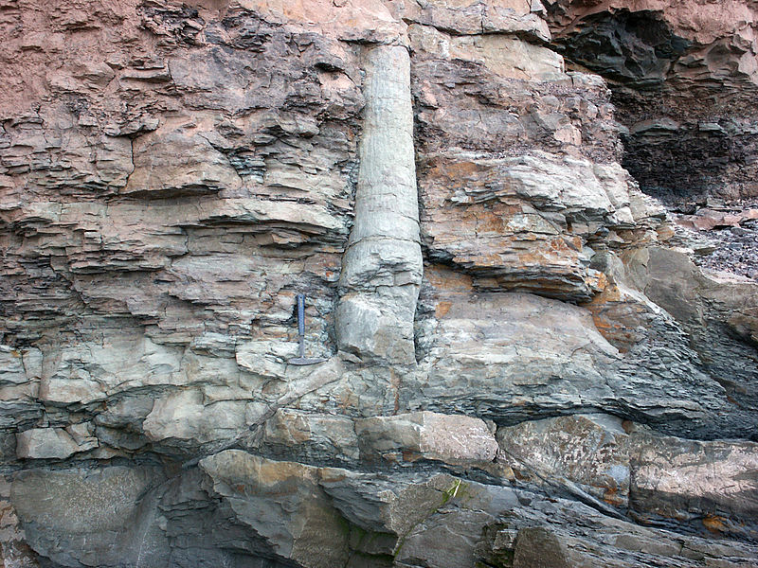
What matters is what does the evidence say?
Polystrate Fossils

Slide 29
https://www.google.com/search?q=pictures+of+polystrate+fossils&tbm=isch&source=univ&sa=X&ved=2ahUKEwi7yK_9zvjjAhWEKM0KHQw3BWMQ7Al6BAgJECQ&biw=1360&bih=657#imgrc=jlhgf6vW8d61LM:

Slide 30
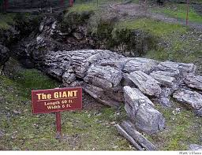
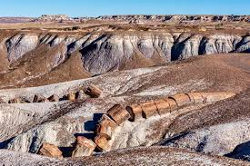
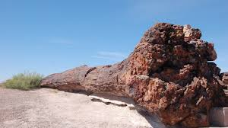
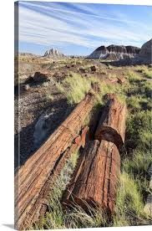
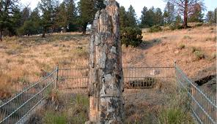
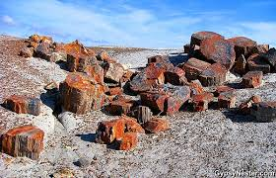

Slide 31
Experts at the time of the 1980 eruption predicted that the area would take perhaps hundreds of years to rebound. Yet after only 20 years, biologists noted the speedy recovery of plants and animals on what had been a vast moonscape.⁶

Slide 32
Today, the 30-year-old blast zone is a lushly treed forest. Creation science models based on the records of Genesis expected to see this happen, since Genesis discloses that God created creatures for the very purpose of “filling” the earth,⁷ and since after the Flood the creatures aboard the Ark were able to quickly adapt to the new environments produced by the cataclysm.
https://www.icr.org/article/a-30-years-later-lessons-mount-st-helens
(Retrieved 08/10/2019)

Slide 33
Because of the Mount St. Helens eruption, scientists know that sedimentary rock layers can form in only hours, rather than requiring millions of years. It also showed that radiometric dating is not necessarily accurate and that God gave animals and plants the ability to rapidly re-colonize barren land.

Slide 34
And the improved seismic prediction techniques that Mount St. Helens facilitated have also increased scientific understanding of earth's geologic activities.
https://www.icr.org/article/a-30-years-later-lessons-mount-st-helens (Retrieved 08/10/2019)

Slide 35
So what about the idea of Genetics and evolution. Initially the argument was that we are genetically close to Chimpanzees, Gorillas, Orangutans, etc.
The Christian answer has been that God is using a good model or similar construction in many other life forms. Much like a good design for a bridge would be used reputedly for various bridges.

Slide 36
“Scientists found additional similarities between the frog genes and human genes. For instance, genes in frogs have very similar neighboring genes as humans about 90 percent of the time. In other words, the frog genome contains the same sort of “gene neighborhoods” as the human genome.”
(University of Rochester Medical Center https://www.urmc.rochester.edu/news/story/2831/genome-sequence-marks-big-leap-forward-for-frog-researchers.aspx Retrieved 08/12/2019)

Slide 37
What that means is these frogs can be used to find answers for cancer research etc. The article goes on to say “dozens of pathogens that infect people, as well as at least one species each of mosquito, fruit fly, flower, worm, dog, rat and chicken.”
While the article mentions evolution and says we parted ways with the frog 360 million years ago, I think these findings support the idea that God used similar building blocks for all sorts of life forms.

Slide 38
The problem with many in the scientific community is they assume evolution to be true and will support it in the face of contrary evidence. The main reason is they don’t want to be held accountable to God.

Slide 39
One last thought. Does our astronomical observations support the idea of the Big Bang?
A leading Astronomer Clyde Tombaugh in his last televised interview stated that he had abandoned the Big Bang theory as the images in this observation did not match what would have happened in an explosion. He went on to state that about two thirds of the astronomers still held to the Big Ban, but the theory would be abandoned in time.
https://www.pbs.org/video/report-santa-fe-produced-kenw-dr-clyde-tombaugh-discoverer-pluto/

Slide 40
Psalm 19
1The heavens declare the glory of God; And the firmament shows His handiwork. 2 Day unto day utters speech, And night unto night reveals knowledge. 3 There is no speech nor language Where their voice is not heard.
4Their line has gone out through all the earth, And their words to the end of the world.

Slide 41
Romans 1
20 For since the creation of the world His invisible attributes are clearly seen, being understood by the things that are made, even His eternal power and Godhead, so that they are without excuse,

